Slide 2
Analysis Lab 2
Time Domain
Frequency Domain
Probability Domain
Sampling from a Discrete Probability Distribution

Slide 3
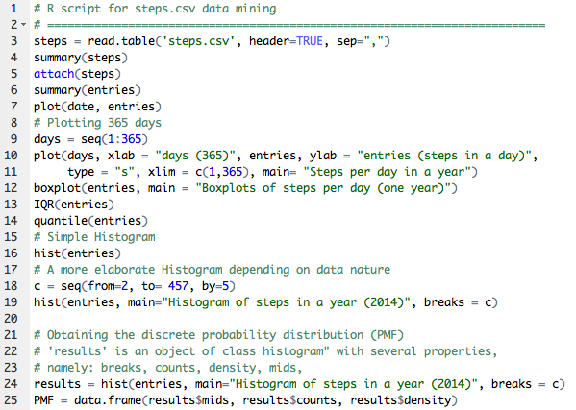
Analysis Lab 2
Time Domain
Frequency Domain
Probability Domain
Sampling from a Discrete
Probability Distribution

Slide 4
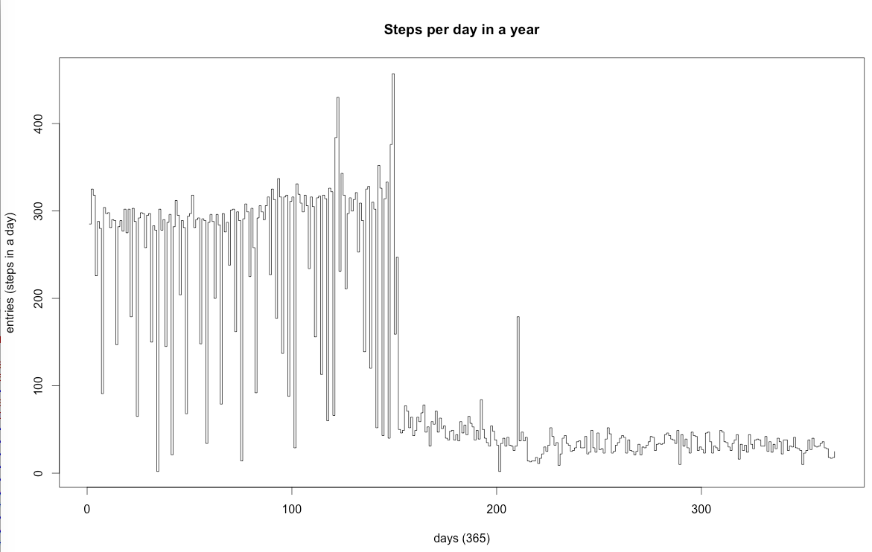
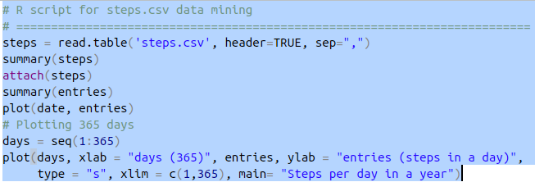
Analysis Lab 2
Time Domain

Slide 5
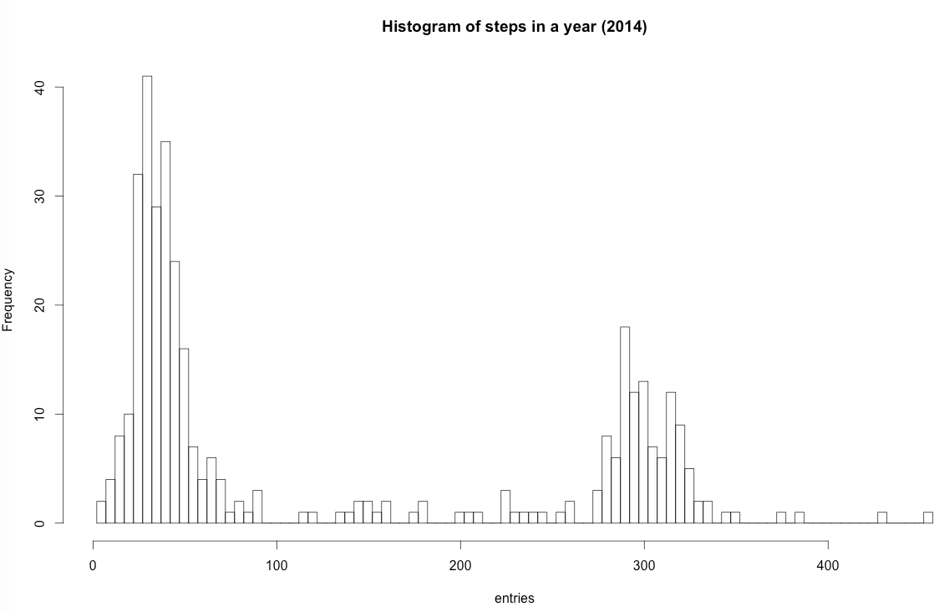
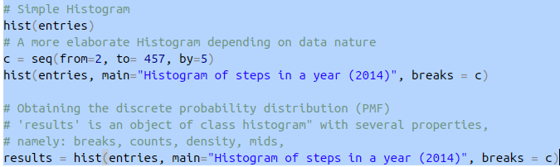
Analysis Lab 2
Frequency Domain

Slide 6
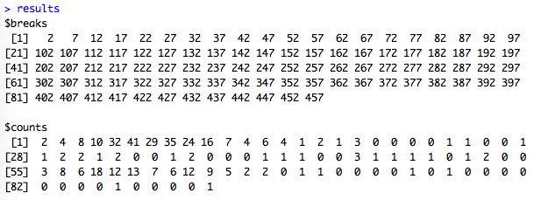
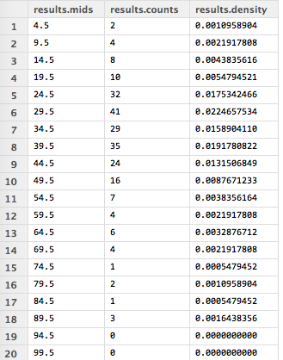
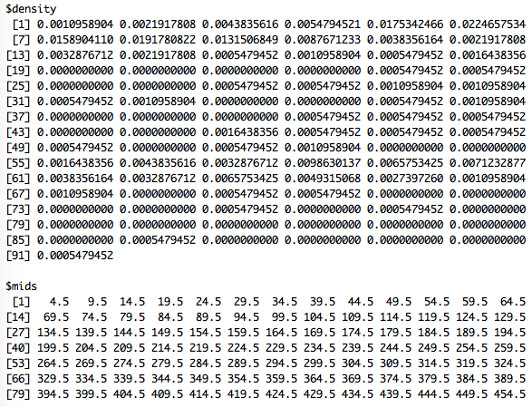
Analysis Lab 2
Probability
Domain
92
91
91
91
...

Slide 7
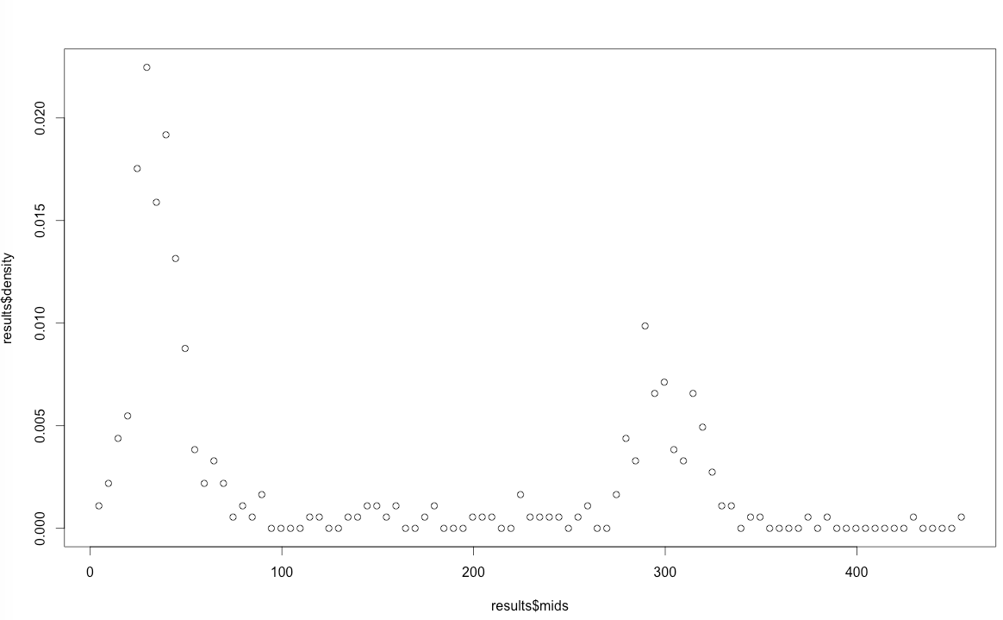
Analysis Lab 2
Probability Domain

Slide 8
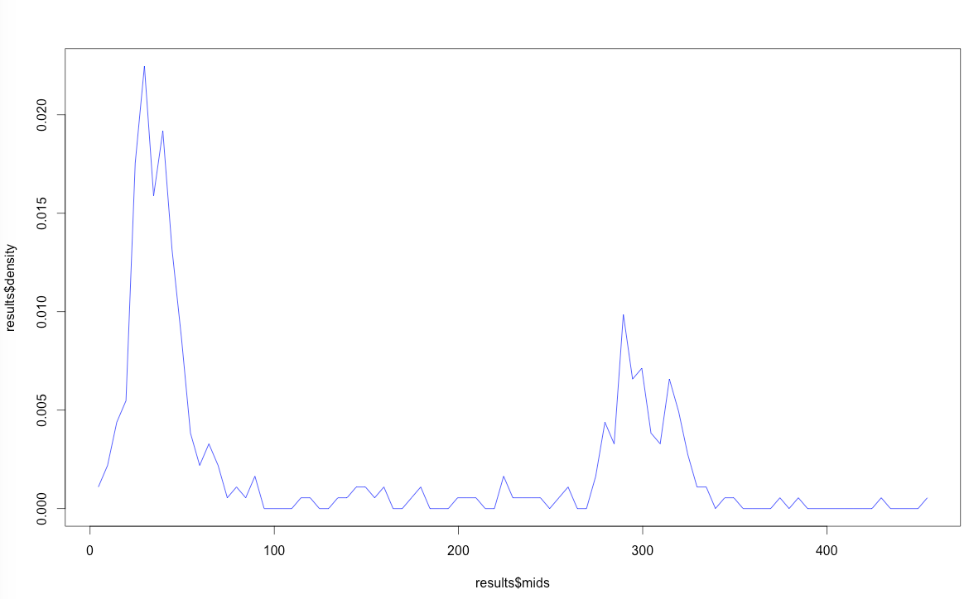
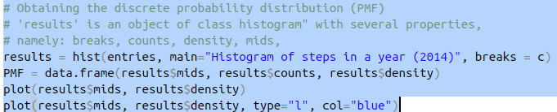
Analysis Lab 2
Probability Domain

Slide 9
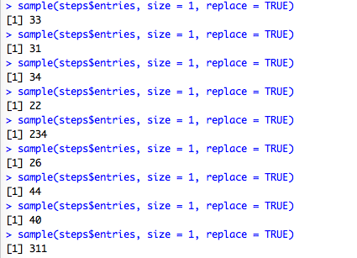
Analysis Lab 2
Sampling from a
Discrete Probabilty
Distribution
Samples entries (number of steps)
at random with equal probability

Slide 10
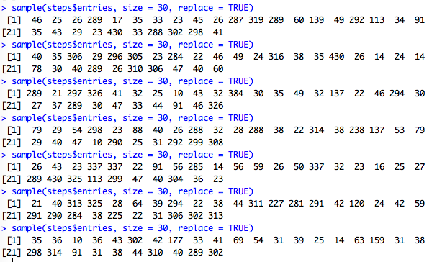
Analysis Lab 2
Sampling from a
Discrete Probabilty
Distribution
Obtaining Samples of 30 entries
at random with equal probability

Slide 11
Analysis Lab 3

Slide 12
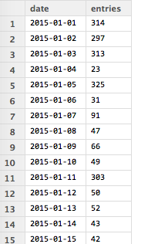
Analysis Lab 3
Sampling from a
Discrete Probabilty
Distribution
How do we simulate a (new)
complete year from “steps" dataframe?

Slide 13
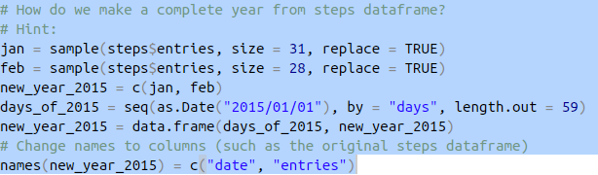
Analysis Lab 3
Sampling from a
Discrete Probabilty
Distribution
(Hint) to simulate a (new)
complete year from “steps" dataframe

Slide 14
Analysis Lab 4
DataFrames

Slide 15
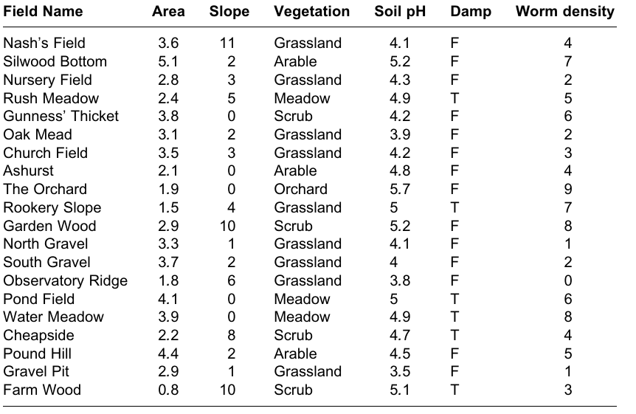
Analysis Lab 4
DataFrames
Here is a spreadsheet in the form of a dataframe with seven variables,
the leftmost of which comprises the row names, and other
variables are numeric (Area, Slope, Soil pH and Worm density),
categorical (Field Name and Vegetation)
or logical (Damp is either true = T or false = F).
worms

Slide 16
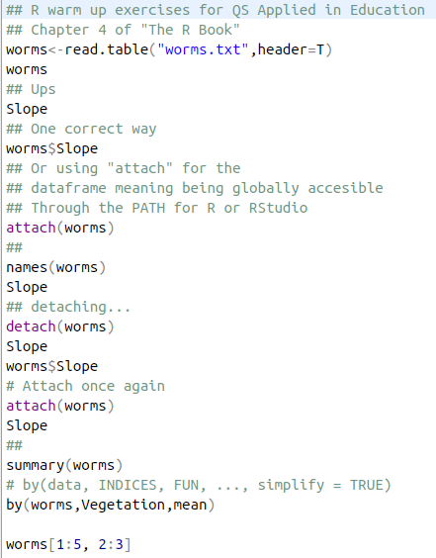
Analysis Lab 4
DataFrames
worms

Slide 17
Analysis Lab 4
DataFrames
worms[3,5]
[1] 4.3
worms[14:19,7]
[1] 0 6 8 4 5 1
Worms[1:5,2:3]
This next point is very important, and is hard to grasp without practice. To select all the entries in a row the syntax is ‘number comma blank’. Similarly, to select all the entries in
a column the syntax is ‘blank comma number’. Thus, to select all the columns in row 3:
worms[3,]
worms

Slide 18
Analysis Lab 4
DataFrames
Whereas
to select all of the rows in column number 3
we enter:
Worms[ ,3]
This is a key feature of the R language. Note
that these two apparently similar commands
create objects of different classes:
class(worms[3, ])
class(worms[ ,3])
worms

Slide 19
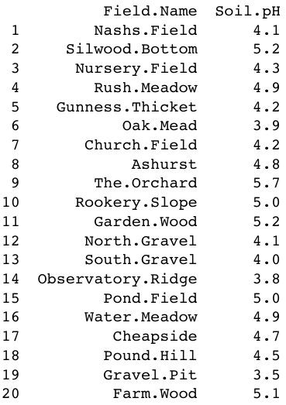
Analysis Lab 4
DataFrames
You can create sets of rows or columns.
For instance, to extract all the rows for Field
Name and the Soil pH (columns 1 and 5)
use the concatenate function, c, to make a vector
of the required column numbers c(1,5):
worms[,c(1,5)]
worms

Slide 20
Analysis Lab 4
DataFrames
Selecting Rows from the Dataframe at Random
In bootstrapping or cross-validation we might want to select certain rows from the dataframe at random.
We use the sample function to do this: the default replace = FALSE performs shuffling (each row is selected once and only once),
while the option replace = TRUE (sampling with replacement) allows for multiple copies of certain rows.
Here we use replace = F to select a unique 8 of the 20 rows at random:
worms[sample(1:20,8),]
{see help(sample)}
worms

Slide 21
Analysis Lab 4
DataFrames
Sorting Dataframes
It is common to want to sort a dataframe by rows, but rare to want to sort by columns.
Because we are sorting by rows (the first subscript) we specify the order of the row subscripts before the comma.
Thus, to sort the dataframe on the basis of values in one of
the columns (say, Slope), we write:
worms[order(Slope), ]
worms

Slide 22
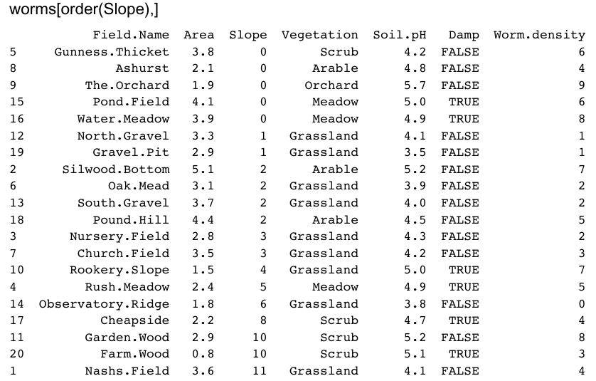
Analysis Lab 4
DataFrames
Sorting Dataframes
worms

Slide 23
Analysis Lab 4
DataFrames
Sorting Dataframes...
If you want the dataframe in reverse order (descending order) then use the rev function outside the order function like this:
worms[rev(order(Slope)), ]
worms

Slide 24
Analysis Lab 4
DataFrames
Sorting Dataframes...
More complicated sorting operations might involve two or more variables.
This is achieved very simply by separating a series of variable names by commas within the order function.
R will sort on the basis of the left-hand variable, with ties being broken by the second variable, and so on.
Suppose that we want to order the rows of the database on worm density within each vegetation type:
worms[order(Vegetation,Worm.density), ]
worms

Slide 25
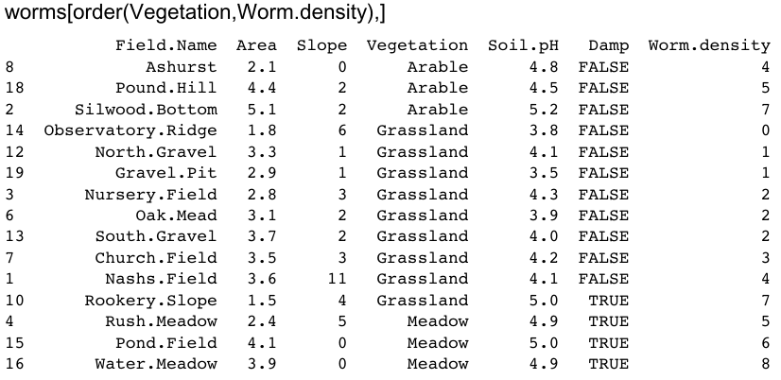
Analysis Lab 4
DataFrames
Sorting Dataframes...
worms

Slide 26
Analysis Lab 4
DataFrames
Sorting Dataframes...
Notice that as with single-condition sorts, when there are ties (as in grassland with worm density = 2), the rows are in their original sequence (here, 3, 6, 13).
We might want to override this by specifying a third sorting condition (e.g. soil pH):
worms[order(Vegetation,Worm.density,Soil.pH), ]
worms

Slide 27
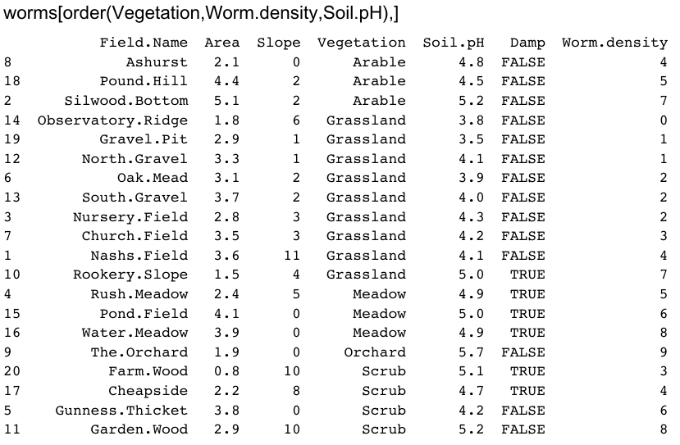
Analysis Lab 4
DataFrames
Sorting Dataframes...
The rule is this: if in doubt, sort using more variables than you think you need. That way you can be absolutely certain that the rows are in the order you expect them to be in.
worms

Slide 28
Analysis Lab 4
DataFrames
Sorting Dataframes...
Perhaps you want only certain columns in the sorted dataframe?
Suppose we want Vegetation, Worm.density, Soil.pH and Slope, and we want them in that order from left to right,
then we specify the column numbers in the sequence we want them to appear as a vector, thus: c(4,7,5,3):
worms[order(Vegetation,Worm.density), c(4,7,5,3)]
worms

Slide 29
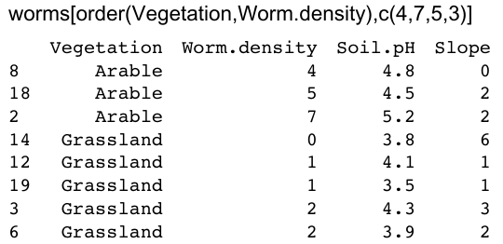
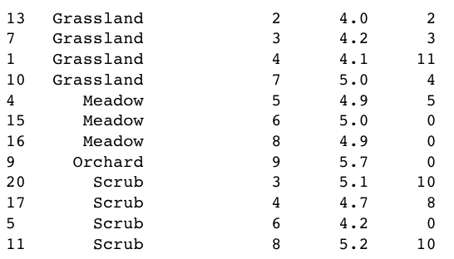
Analysis Lab 4
DataFrames
Sorting Dataframes...
worms

Slide 30
Analysis Lab 4
DataFrames
Sorting Dataframes...
You can select the columns on the basis of their variables names, but this is more fiddly to type, because you need to put the variable names in quotes like this:
worms[order(Vegetation,Worm.density),
c("Vegetation", "Worm.density", "Soil.pH", "Slope")]
worms

Slide 31
Analysis Lab 4
DataFrames
Using Logical Conditions
to Select Rows from the Dataframe
A very common operation is selecting certain rows from the dataframe on the basis of values in one or more of the variables (the columns of the dataframe).
Suppose we want to restrict the data to cases from damp fields.
We want all the columns, so the syntax for the subscripts is [‘which rows’, blank]:
worms[Damp == T, ]
worms

Slide 32
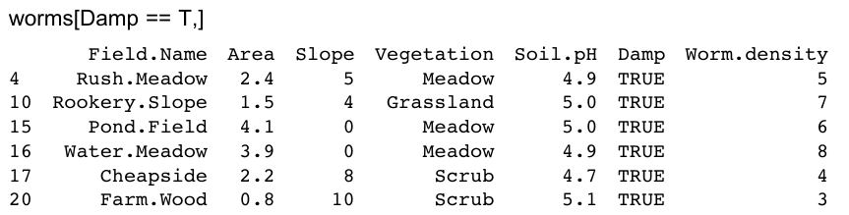
Analysis Lab 4
DataFrames
Using Logical Conditions
to Select Rows from the Dataframe
Note that because Damp is a logical variable (with just two potential values, TRUE or FALSE) we can refer to true or false in abbreviated form, T or F.
T in this case is not enclosed in quotes: the T means true, not the character string ‘T’.
The symbol for the logical condition is == (two successive equals signs with no gap between them)
worms

Slide 33

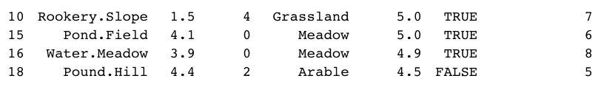
Analysis Lab 4
DataFrames
Using Logical Conditions
to Select Rows from the Dataframe
Suppose that we wanted the data from the fields where worm density was higher than the median (>median(Worm.density)) and soil pH was less than 5.2.
In R, the logical operator for AND is the & symbol:
worms[Worm.density > median(Worm.density) & Soil.pH < 5.2, ]
worms

Slide 34
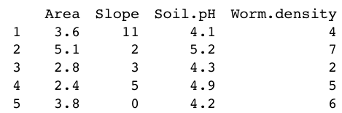
Analysis Lab 4
DataFrames
Using Logical Conditions
to Select Rows from the Dataframe
Suppose that we want to extract all the columns that contain numbers (rather than characters or logical variables) from the dataframe.
The function is.numeric can be applied across all the columns of worms using sapply to create subscripts like this:
Worms[ ,sapply(worms,is.numeric)]
worms

Slide 35
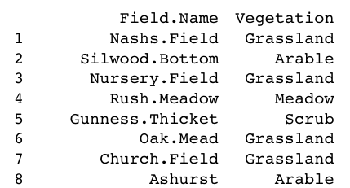
Analysis Lab 4
DataFrames
Using Logical Conditions
to Select Rows from the Dataframe...
We might want to extract the columns that are factors:
Worms[ ,sapply(worms,is.factor)]
Because worms is a dataframe, the characters have all been coerced to factors, so worms[ ,sapply(worms,is.character)] produces the answer NULL.
worms

Slide 36
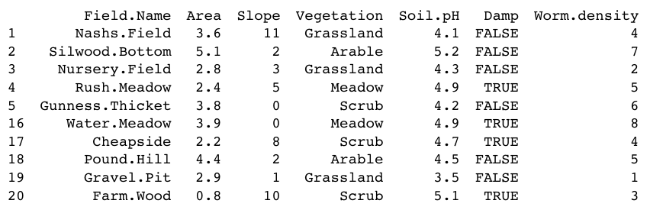
Analysis Lab 4
DataFrames
Using Logical Conditions
to Select Rows from the Dataframe...
To drop a row or rows from the dataframe, use negative subscripts. Thus to drop the middle 10 rows (i.e. row numbers 6 to 15 inclusive) do this:
Worms[-(6:15), ]
worms

Slide 37
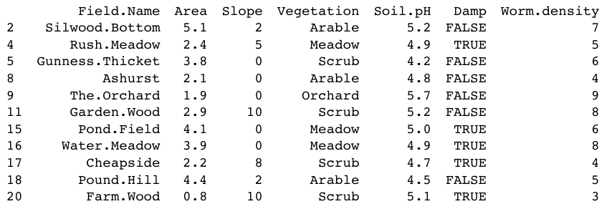
Analysis Lab 4
DataFrames
Using Logical Conditions
to Select Rows from the Dataframe...
Here are all the rows that are not grasslands (the logical symbol ! means NOT):
worms[!(Vegetation=="Grassland"),]
worms

Slide 38
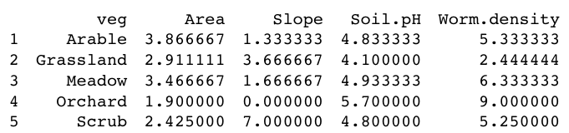
Analysis Lab 4
DataFrames
Summarizing the Contents of Dataframes
The other useful function for summarizing a dataframe is aggregate.
aggregate(worms[ ,c(2,3,5,7)], by=list(veg=Vegetation), mean)
help(aggregate)
worms

Slide 39
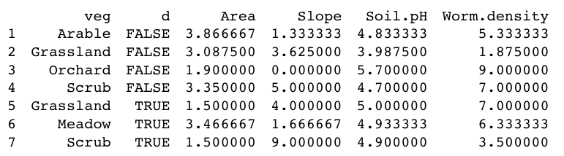
Analysis Lab 4
DataFrames
Summarizing the Contents of Dataframes
The by argument needs to be a list even if, as here, we have only one classifying factor.
Here are the aggregated summaries for Vegetation and Damp:
aggregate(worms[ ,c(2,3,5,7)], by=list(veg=Vegetation,d=Damp), mean)
worms

Slide 40
Optional subjects
Conclusions
Further work

